Slide 1

STOCK PREDICTION
ST. GONSALO GARCIA COLLEGE OF ARTS AND COMMERCE
Vasai Road(W) Maharashtra 401202
DEPARTMENT OF INFORMATION TECHNOLOGY
Under the Guidance of : Prof. Calvina Maharao.

Slide 2

STOCK PREDICTION
By:
Rechael Vincent lopes
Seat no. 4136040

Slide 3

AIM
In current times the demand for buying and selling of stocks and also the general interest of public in stock marketing has increased.
Stock market prediction is the act of trying to determine the future outcomes of the company’s stock or other financial memos traded on an exchange.
The project aims to predict the actual and closing price of any stock along with the actual and predicted graph.

Slide 4

HARDWARE REQUIRMENTS
Processor: AMD A6-4455M APU 2.10GHz or above.
Hard-disk space: 20GB or above.
Display: Colour Monitor.
MEMORY REQUIRMENT
128MB of RAM.

Slide 5


SOFTWARE REQUIRMENTS
Python:
Python is a high-level, general-purpose programming language which supports multiple programming paradigms like structed, object oriented and functional programming.
Steamlit:
Steamlit software is used to turn data scripts into shareable web apps. Its based on python and is an open source software.

Slide 6

OBJECTIVES
This project focuses on maximizing the investor’s profit by predicting the future outcomes.
It can benefit the economy of a company and can help users make wise investment choices.
It can be applied to various fields like finance, stock market, small/large businesses, personal use, etc.
The goal of stock prediction is to help organizations deliver maximum business value.

Slide 7
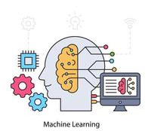
ALGORITHM
The proposed system is based on the Long Short Term Memory (LSTM) Algorithm, an artificial neural network that is based on a Machine Learning Algorithm and is in the field of Deep Learning.
The algorithm uses a set of Training Data and Test Data and implements the results.

Slide 8
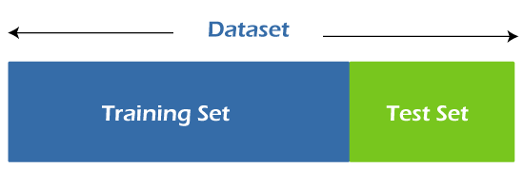
DATA FLOW FOR THE ALGORITHM
Train and Test dataset are two key components of any machine learning model.
The Training dataset is bigger in size and a subset of the original dataset that is used to train the machine learning model.
The Testing dataset is a smaller subset of the original dataset independent of the training dataset.

Slide 9
LSTM AND RNN
LSTM Algorithm is based on the principles of an Advance Neural Network.
A Neural Network depicts the way a human brain works.
The purpose of an Artificial Neural Network in to make computers understand and work in human like format.
LSTM works as a Recurrent Neural Network that is the output from the previous step is fed as an input to the current step

Slide 10
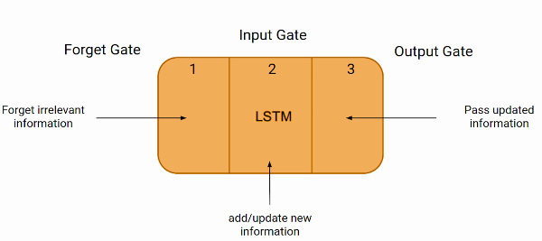
ARCHITECTURE OF THE LSTM ALGORITHM

Slide 11
The Forget Gate:
The Forget Gate Does the task of discarding the data that is no longer useful.
The Input Gate:
Once the information is filtered and ready to use it is then passed on through the Input Gate as an input to the algorithm.
The LSTM algorithm then processes this information. It also adds new updates to the information.
The Output Gate:
The Output Gate does the task of passing the processed and updated information form the current step to the next.

Slide 12
WORKING OF THE ALGORITHM
Input : Yahoo (Stock) Dataset.
Output : Prediction of Stock Prices for the particular Stock.
Step 1:
Stock Data is downloaded and stored in a NumPy array of three dimension.
Step 2:
A network structure is build with [1, a, b] dimensions where;
1 is the input layer,
a is the neuron in the next layer, and
b are the neurons in the subsequent layers with a linear activation function.
Step 3:
Train the constructed network with the help of training data.

Slide 13
Step 4:
Use the output of the last layer as the prediction for the current layer.
Step 5:
Repeat step 3 and step 4 until optimal convergence is reached.
Step 6:
Obtain prediction by providing test data as input to the network.
Step 7:
Evaluate the accuracy of the network.
Step 8:
End.

Slide 14

SCOPE
The Long Short Term Memory Algorithm can be used in various different fields to predict the future outcome like:
Health Care Facilities.
Traffic Controlling.
Event Sourcing.
Weather Forecasting.

